Slide 1


Business and Information Technology
BSBCRT404 Apply advanced critical thinking to work processes – Sessions 1 & 2

Slide 2
Introduction to BSBCRT404 Apply advanced critical thinking to work processes
Introduction to Critical Thinking
Critical Thinking in Your Life
Skills You Should Cultivate
Avoiding Logical Fallacies
Causal Relationships

Slide 3
What is Critical Thinking?
Discuss as a class ‘what is critical thinking?’
What does it look or feel like?
When would you do it?
How would you do it?
Is it always possible?
Who uses critical thinking in their job / career?

Slide 4
Basic Approach to CT in the Workplace
Develop critical thinking mindset
Understand critical thinking in a workplace context
Apply a systematic approach to decision making

Slide 5
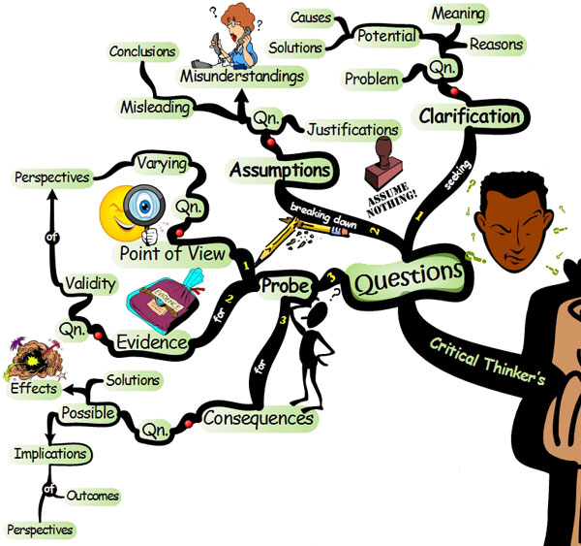
Critical Thinking
“The important thing is not
to stop questioning. Curiosity
has its own reason for existing”
- Albert Einstein

Slide 6
Critical Thinking in Your Life
Personal Life
What constitutes a healthy diet?
Which investment is better for my family? Why?
Professional Life
In what ways can we improve our product?
How do the actions of our company affect others? The environment?
Academic Life
What are the main points of this text?
Which major should I choose…why?
Spiritual Life
How do these teachings apply to my life?
Are there contradictions in what is being said?

Slide 7
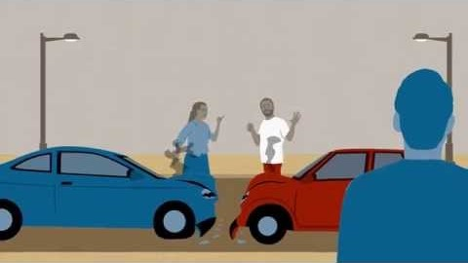

Slide 8
Skills You Should Cultivate
Become an active learner
“Chase” answers.
Actively seek out solutions.
Go to the answer, don’t wait for it to come to you.
Become open-minded
Is it possible that there are multiple correct answers?
You might be wrong. Why?
Try and approach problems from a different perspective.
Separate Emotions from Facts
“Thinking” and “feeling” are not the same.
Avoid Logical Fallacies
2 + 2 = 5. Incorrect.

Slide 9
Active Learning
Attend class regularly
Take advantage of extra credit opportunities.
Participate in discussions.
Talk with your professors.
Read textbooks
Take notes and outline information.
Review notes and try to put them in your own words.
Attend Tutoring
Take the new information you have gathered, try it out and experiment with it.
Why is it relevant?
What does it mean?
What is the purpose of knowing the information?

Slide 10
Things to Keep in Mind
Keep an open mind
Your perspective is yours. Others have different perspectives.
It is possible that you are “wrong” and that others are “right”.
Get comfortable with being “wrong”. Learn from it.
Consider many different viewpoints.
Accept a new explanation if it explains the evidence better and has fewer contradictions.
Think before you act
Separate your feelings from the facts.
Am I acting because of an emotional impulse, or because it is logical?
Do I believe something because of the logic behind it?

Slide 11

Avoid Logical Fallacies
A logical fallacy is a misunderstanding derived from faulty reasoning.
Avoid contradictions between answers.
Is your best answer a logical answer?
Does it makes sense?
Example of a Logical Fallacy:
Beware of generalisations e.g. Coal pays for coffee machines
https://www.facebook.com/TheAustraliaInstitute/videos/155992343140948/

Slide 12
You must be
willing to say,
“I don’t know.”
And then be willing to do something to change that.

Slide 13
Causal Relationships
Coal pays for barista machines
What connection is there?
Two important rules:
Cause must precede the effect in time
Correlation does not prove causation

Slide 14
In these sessions we looked at:
An introduction to Critical Thinking and what it is
Critical Thinking and how it can be applied in your life
Skills you should cultivate to become a critical thinker
Recognising and avoiding logical fallacies
Communicating causal relationships

Slide 15
Further Reading, Activities and Assessments
Open the student Workbook and read pages 7 – 11
Complete Activity 1 on pg 12 (either individually or as a class)
Open AT01 and complete Q1
Open AT02 and complete Q1

